Slide 1

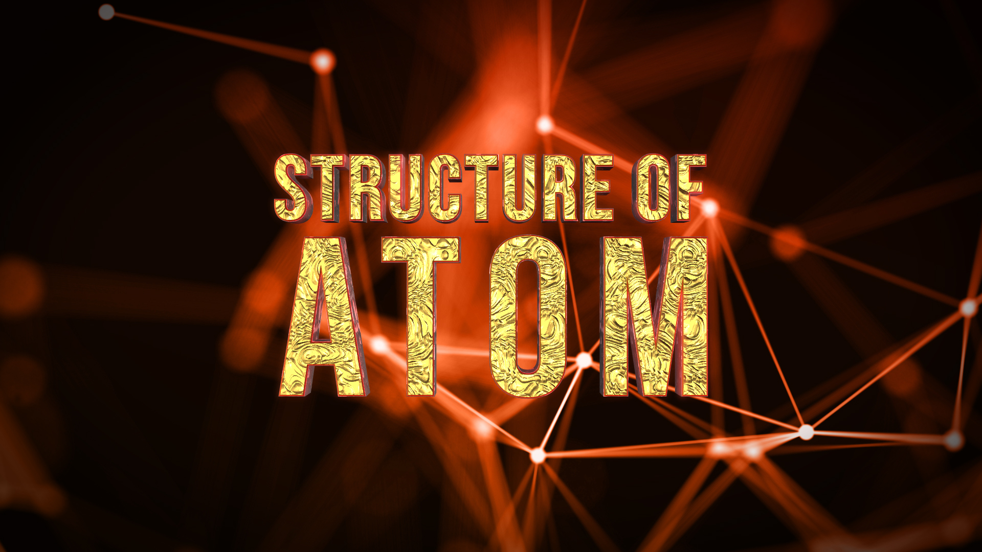
STRUCTURE OF ATOM

Slide 2


Syllabus
Nature of electromagnetic radiation, photoelectric effect; Spectrum of the hydrogen atom. Bohr model of a hydrogen atom - its postulates, derivation of the relations for the energy of the electron and radii of the different orbits, limitations of Bohr's model; Dual nature of matter, de Broglie's relationship. Heisenberg uncertainty principle.
Elementary ideas of quantum mechanics, quantum mechanics, the quantum mechanical model of the atom, its important features. Concept of atomic orbitals as one-electron wave functions: Variation of Ψ and Ψ ² with r for 1s and 2s orbitals: various quantum numbers and their significance; shapes of s, p, and d - orbitals, electron spin and spin quantum number:
Rules for filling electrons in orbits - Aufbau principle. Pauli's exclusion principle and Hund's rule, electronic configuration of elements, extra stability of half-filled and completely filled orbitals.

Slide 3
What is Everything Made of???
WHY SO DIVERSITY

Slide 4
Basic Idea about Atom
&
Sub Atomic Particles

Slide 5

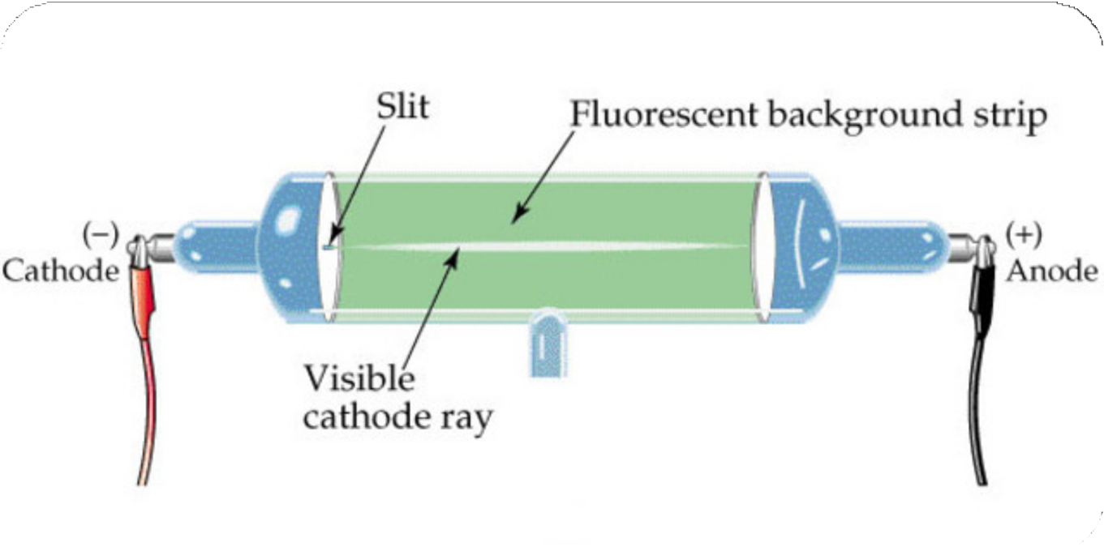

Slide 6
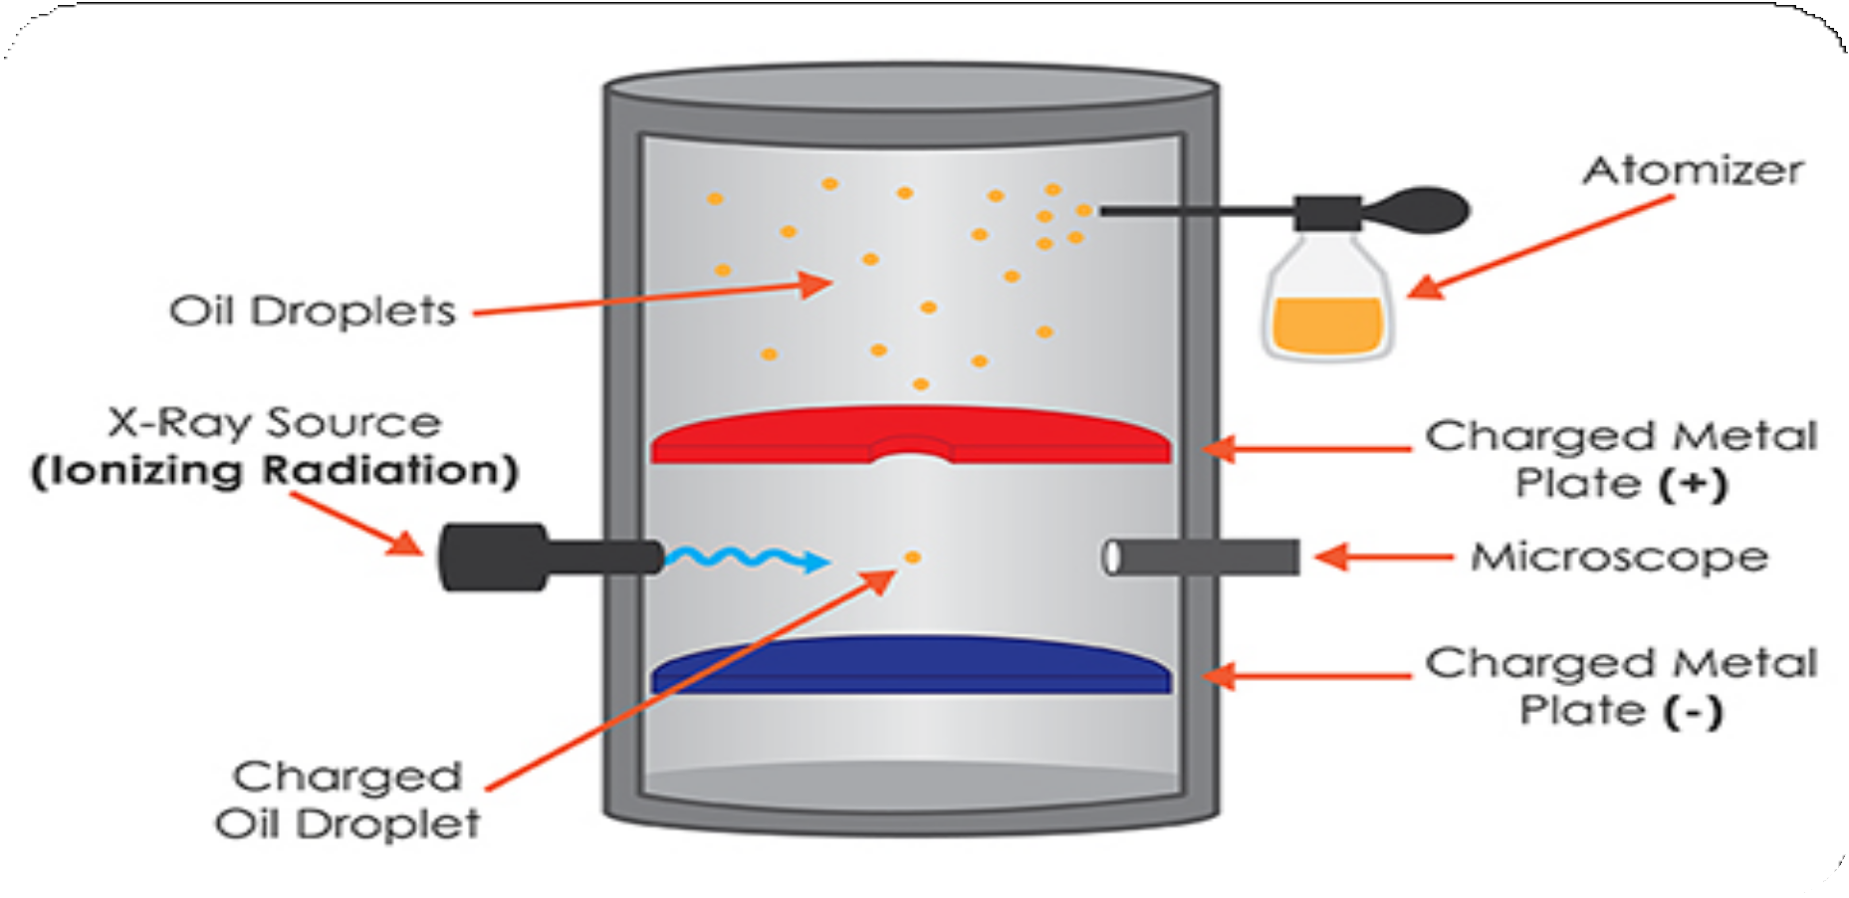
Millikan’s Oil drop experiment
1.6022 x 10⁻¹⁹C
1.758820 x 10¹¹C kg⁻¹
m = ^{e} =
= 9.1094 x 10⁻³¹kg
e/m_{e}

Slide 7
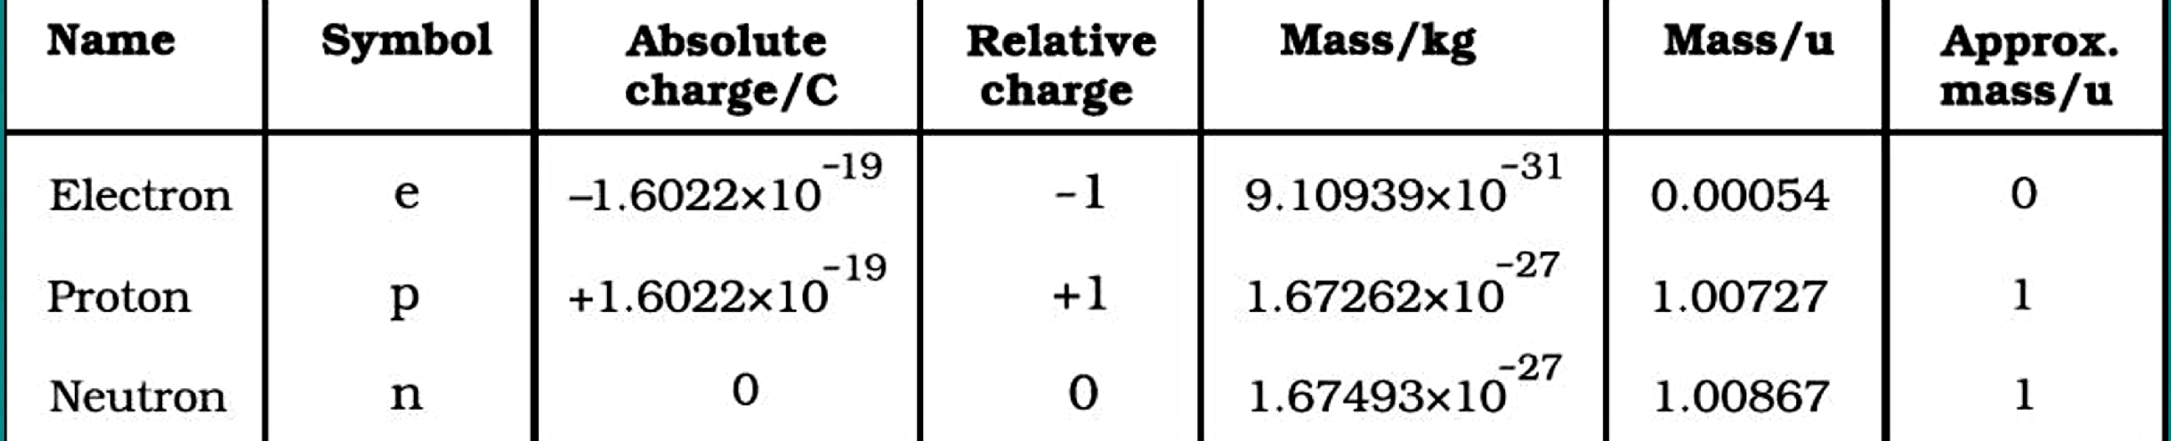

Slide 8
Questions
The size of nucleus is of the order of
1. 10⁻¹² m 2. 10⁻⁸ m 3. 10⁻¹⁵ m 4. 10⁻¹⁰ m

Slide 9
Questions
The minimum real charge on any particle which can exist is
1. 1.6 x 10⁻¹⁹ Coulomb 2. 1.6 x 10⁻¹⁰ Coulomb
3. 4.8 x 10^{-10‑} Coulomb 4. Zero

Slide 10
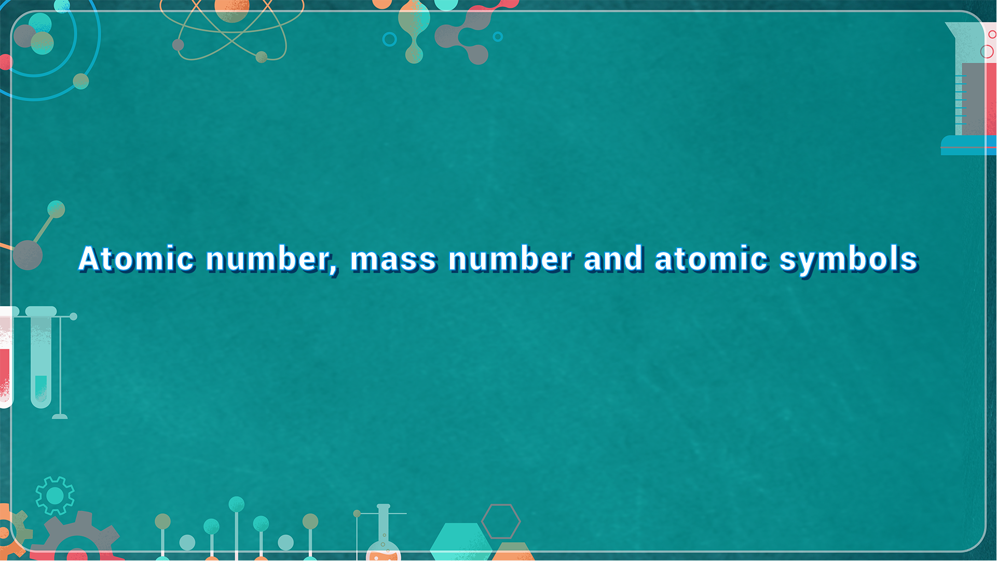
Atomic number, Mass number
and Atomic symbols

Slide 11
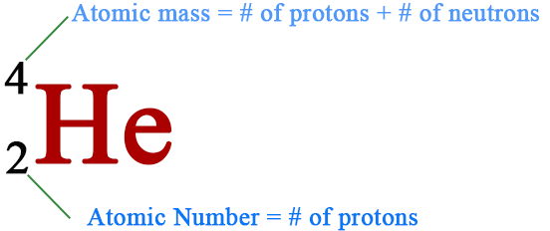
Atomic number, mass number and atomic symbols

Slide 12
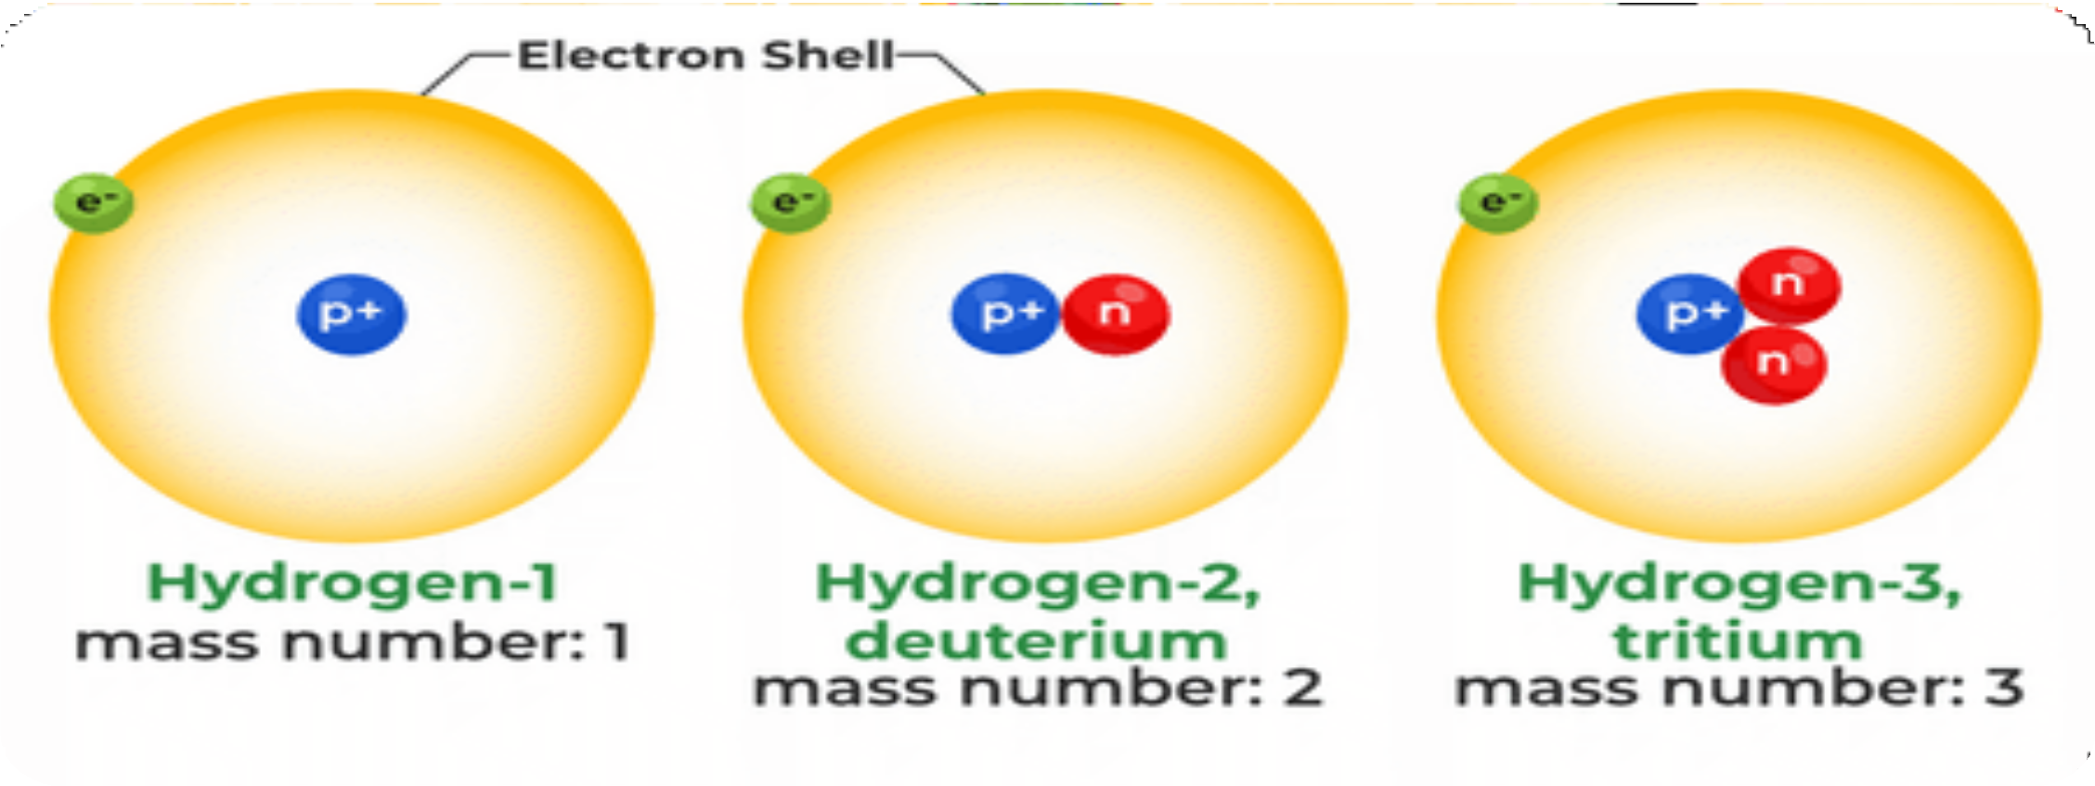
Isotopes
Atoms of the same element having same atomic number( p⁺), but different mass number (p⁺+ n⁰)

Slide 13
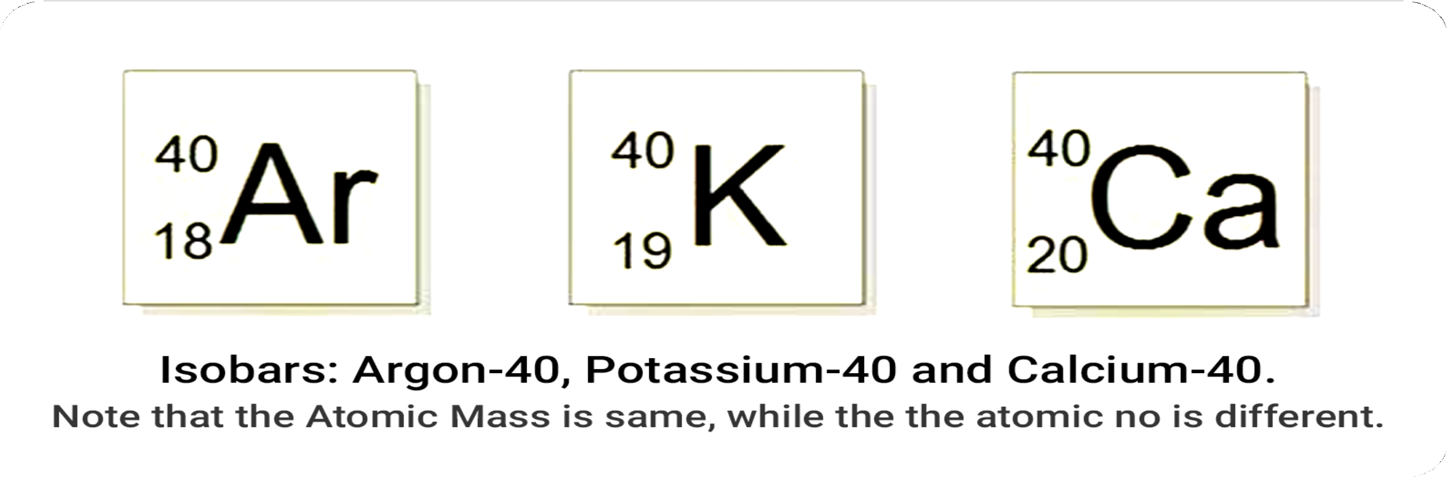
Isobars
Atoms of different elements having same mass number.

Slide 14
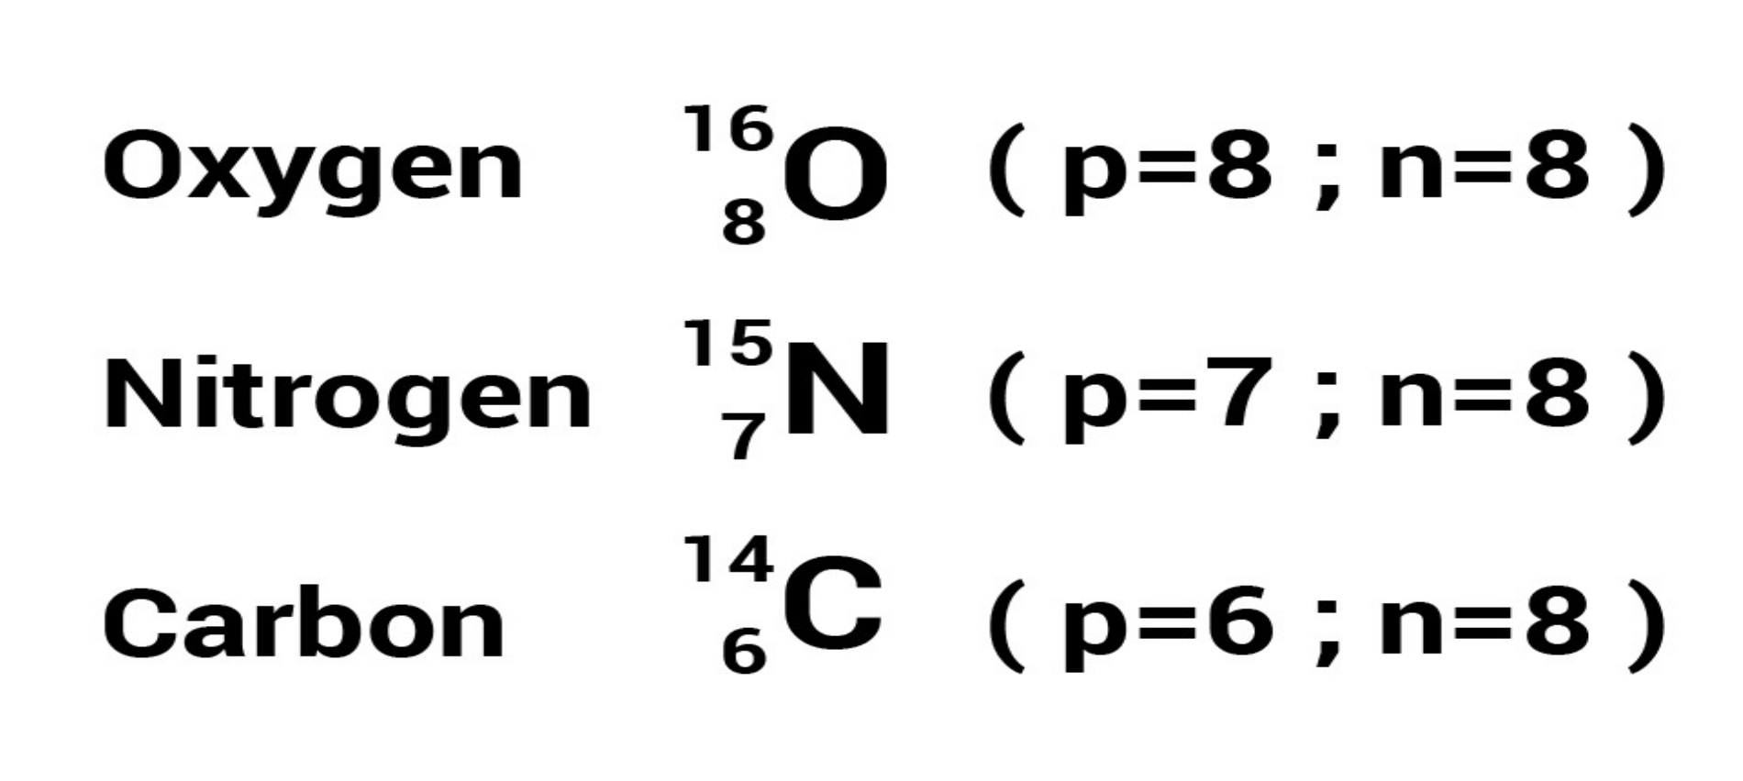
Isotones
Atoms of different elements having same number of neutrons.

Slide 15
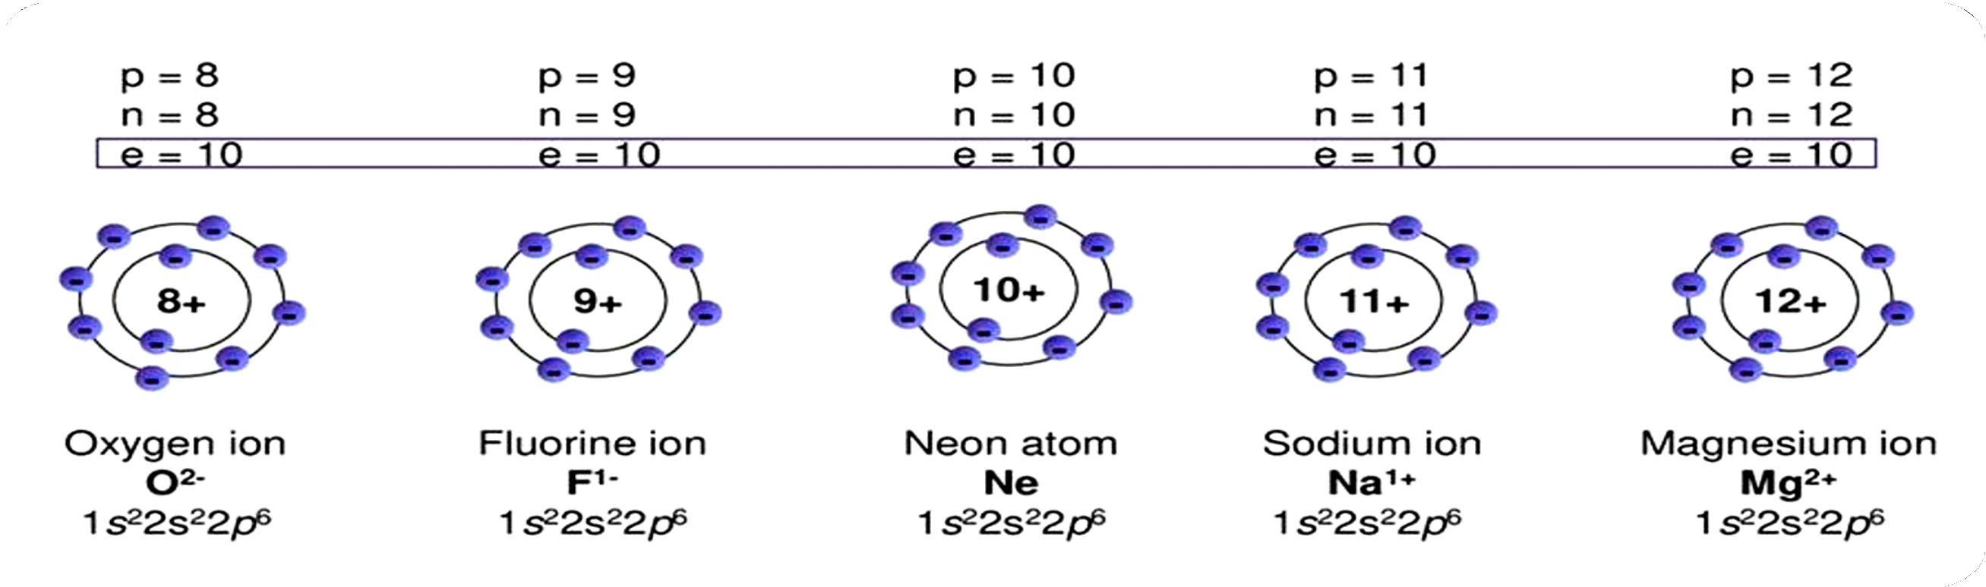
Isoelectronic species
Species having same number of electrons.

Slide 16
Questions
The mass number of an anion, X³⁻, is 14. If there are ten electrons in the anion, the number of neutrons in the nucleus of atom, X₂ of the element will be
1. 10 2. 14 3. 7 4. 5

Slide 18
Questions
Which of the following are isoelectronic species
I= CH₃⁺, II=NH₂⁻, III=NH₄⁺, IV=NH₃
1. I,II,III 2. II,III, IV 3. I,II, IV 4. I and II

Slide 20
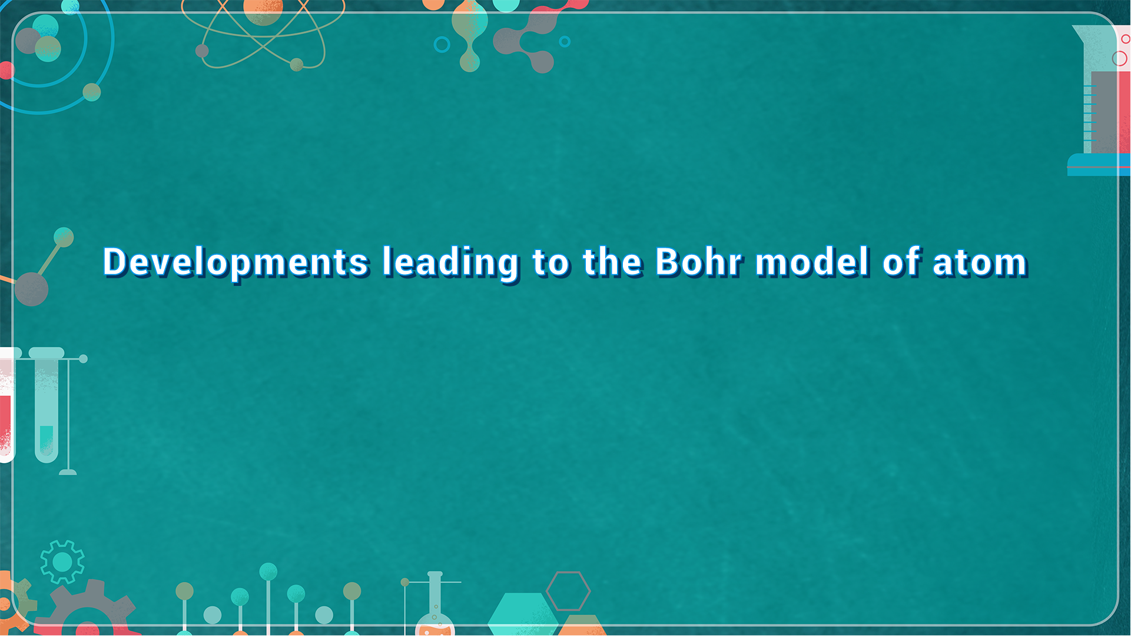
Developments Leading to the Bohr Model of Atom

Slide 21
Developments leading to the Bohr model of atom
Two developments played a major role in the formulation of Bohr’s model of atom:
Dual nature of electromagnetic radiation.
Experimental results regarding atomic spectra which could be explained only using quantized energy levels in atoms.

Slide 22
Wave nature of Electromagnetic Radiation
What is a wave?
A wave can be described as a disturbance that travels through a medium or space, transporting energy from one location to another location.

Slide 23
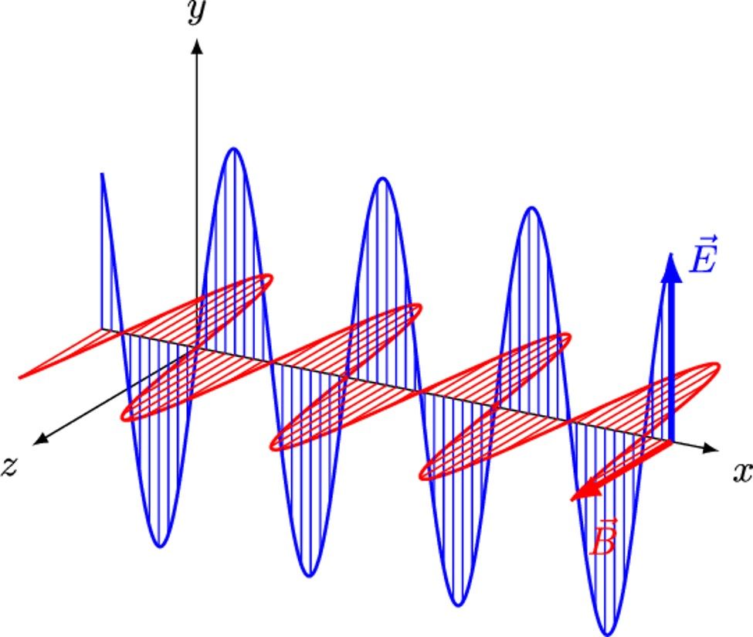
When electrically charged particle moves under acceleration, alternating electrical and mag- netic fields are produced and transmitted. These fields are transmitted in the form of waves called Electromagnetic Waves.
Electric component, magnetic component and direction of propagation of wave, all are mutually perpendicular to each other.

Slide 24
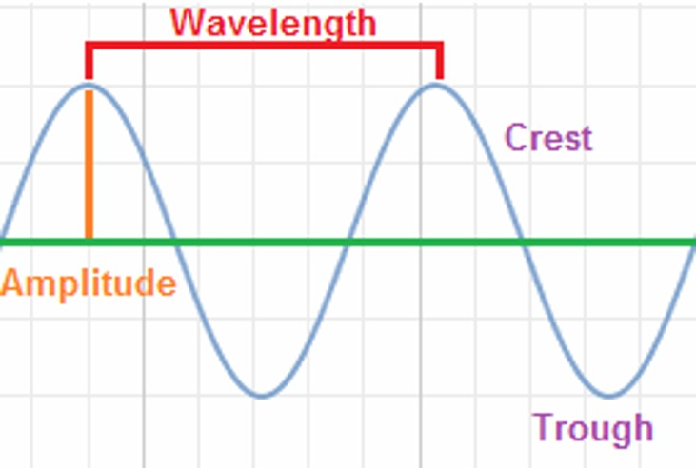
Wavelength (λ)
Distance between two neighbouring crests or troughs of a wave.
Frequency (v)
Number of waves which pass through a particular point in one second.
S.I unit= Hertz(Hz) or cycles per second. 1 cpz= 1 Hz; 1KHz= 10³Hz; 1MHz= 10⁶Hz
Speed (c)
Speed of light. (c=3x10⁸ ms⁻¹) c=v x λ
v 1/λ

Slide 25
Amplitude (A)
Height of the crest or depth of the trough.
Wave number (v )
Number of wavelengths per unit length.

Slide 26
Questions
The wave number of the microwaves with wavelength 4 x 10⁷ nm
1. 0.25 x 10²m⁻¹ 2. 2.5 x 10²m⁻¹
3. 4 x 10²m⁻¹ 4. 8 x 10²m⁻¹

Slide 28
Questions
The MRI (Magnetic resonance imaging) body scanners used in hospitals operate with 400 MHz radio frequency energy. The wavelength corresponding to this radio frequency is
1. 0.75 m 2 0.75 cm 3. 1.5 m 2. 2 cm

Slide 30
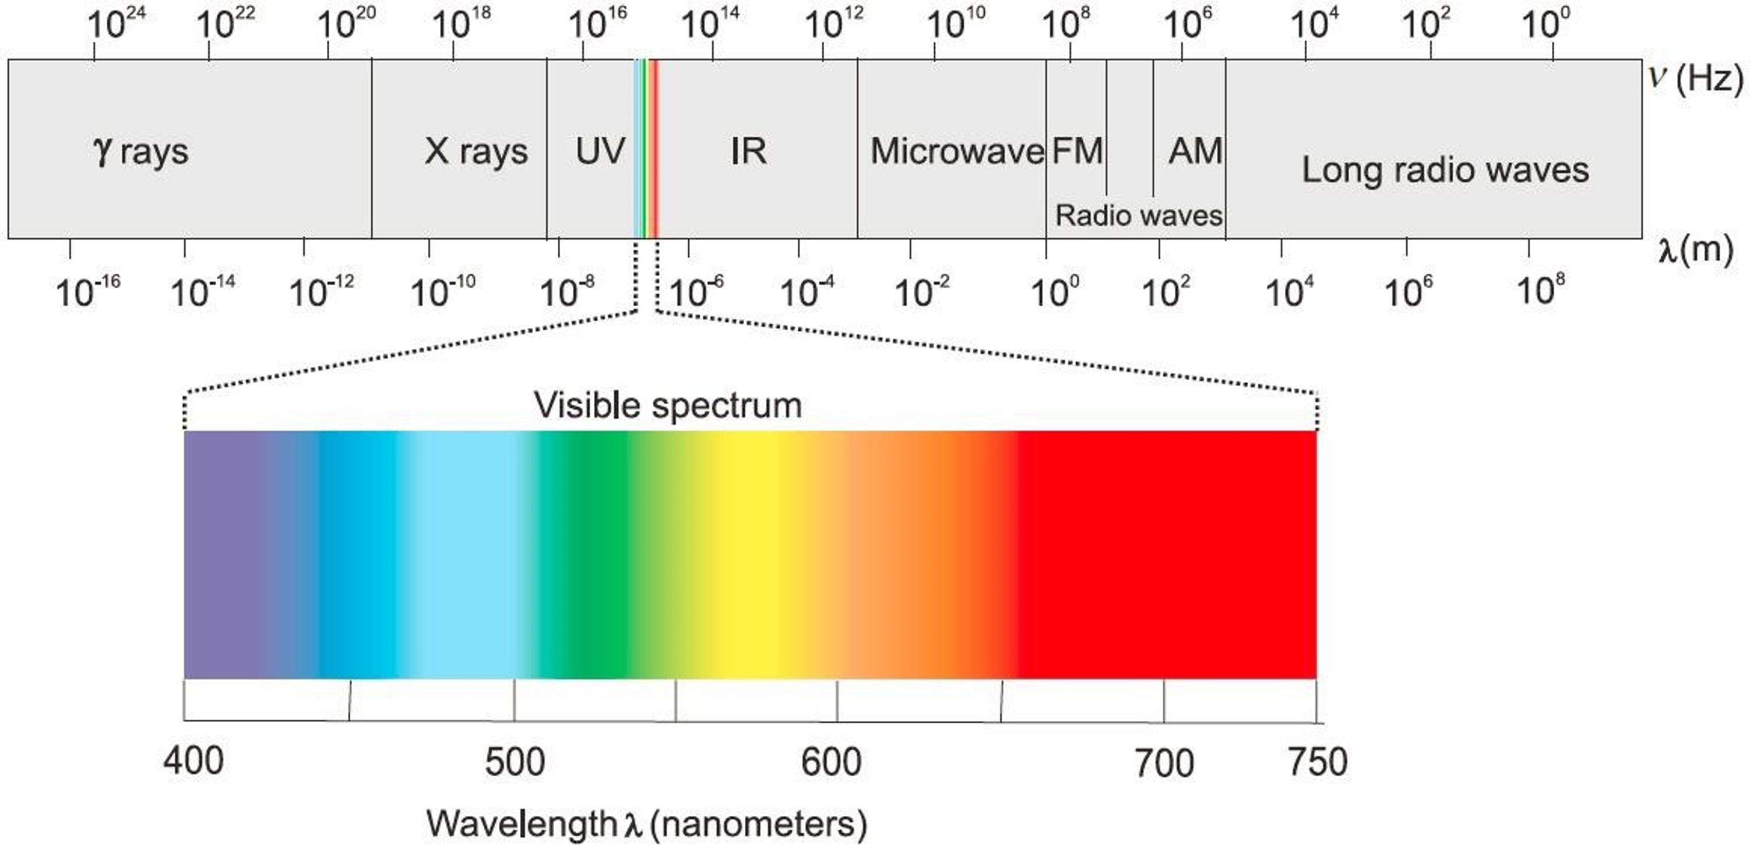

Slide 31
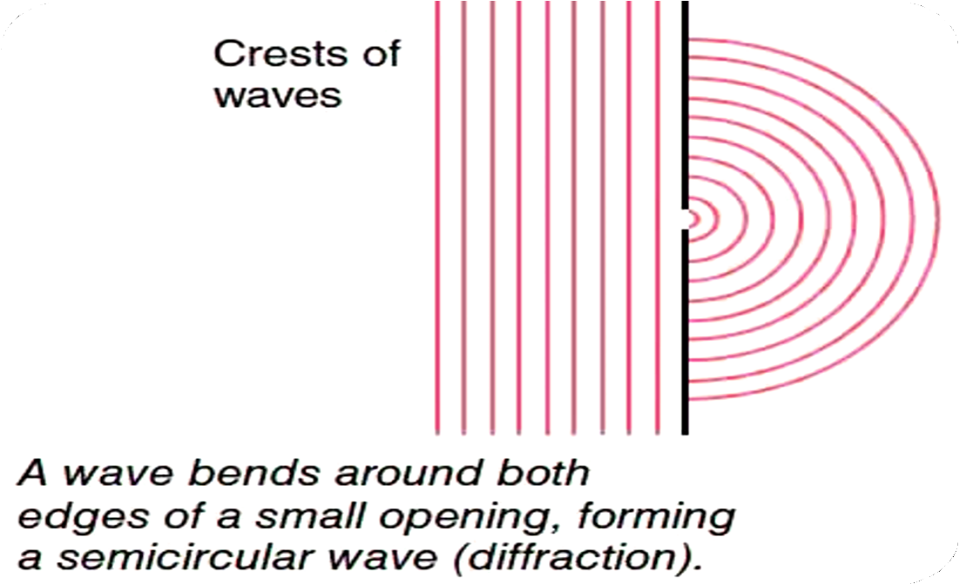
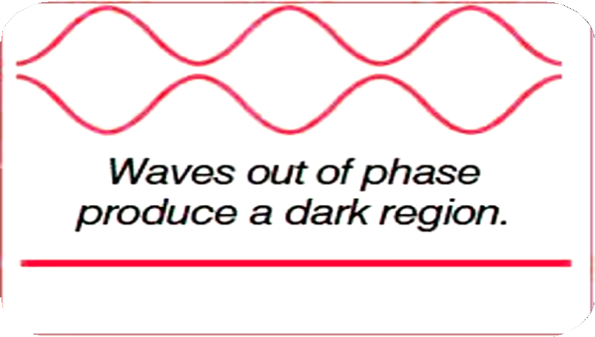

Particle nature of Electromagnetic Radiation
Phenomenon such as diffraction and interference can be explained only by the wave nature of electromagnetic rays.
Constructive interference
Destructive interference

Slide 32
Wave nature or classical physics failed to explain:
Nature of emission of radiation from hot bodies.(Black body radiation)
Photoelectric effect.
Variation of heat capacity of solids as a function of temperature.
Line spectrum of hydrogen.

Slide 33
Black-Body Radiation
An object emits electromagnetic radiation over a wide range of wavelengths when heated.
“The ideal body, which emits and absorbs all frequencies, is called a black body and the radiation emitted by such a body is called black-body radiation”.

Slide 34
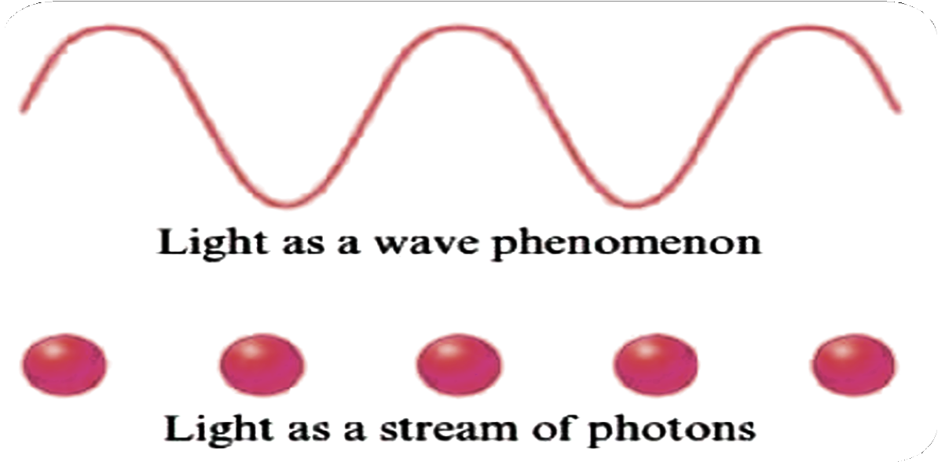
Planck’s Quantum theory
Planck suggested that atoms and molecules could emit or absorb energy only in discrete quantities and not in a continuous manner.
“Quantum”
smallest quantity of energy that can be emitted or absorbed in
the form of electromagnetic radiation.

Slide 35
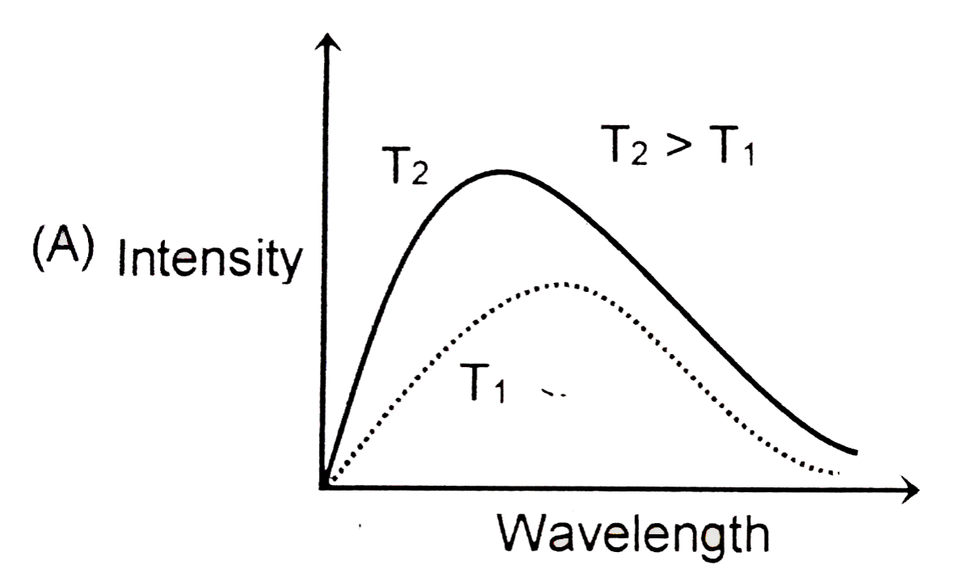

Slide 36
Questions
A 100 watt bulb emits monochromatic light of wavelength 400 nm, then the number photons emitted per second by the bulb
1. 5 x 10² 2. 8 x 10²⁴
3. 6.6 x 10¹⁶ 4. 2.012 x 10²⁰

Slide 38
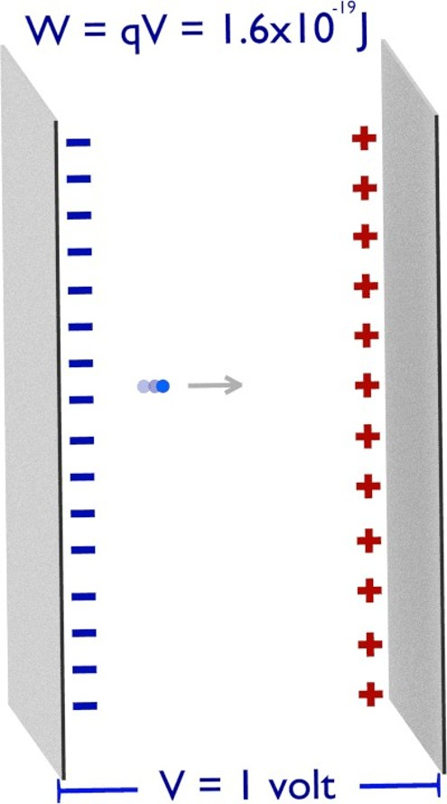
1 electron volt (eV):
Energy gained by an electron when it is accelerated from rest through a potential difference of 1 volt.
1eV= 1.6 x10⁻¹⁹C x 1 volt = 1.6 x 10⁻¹⁹ J
4eV= 4 x 1.6x10⁻¹⁹ J

Slide 39
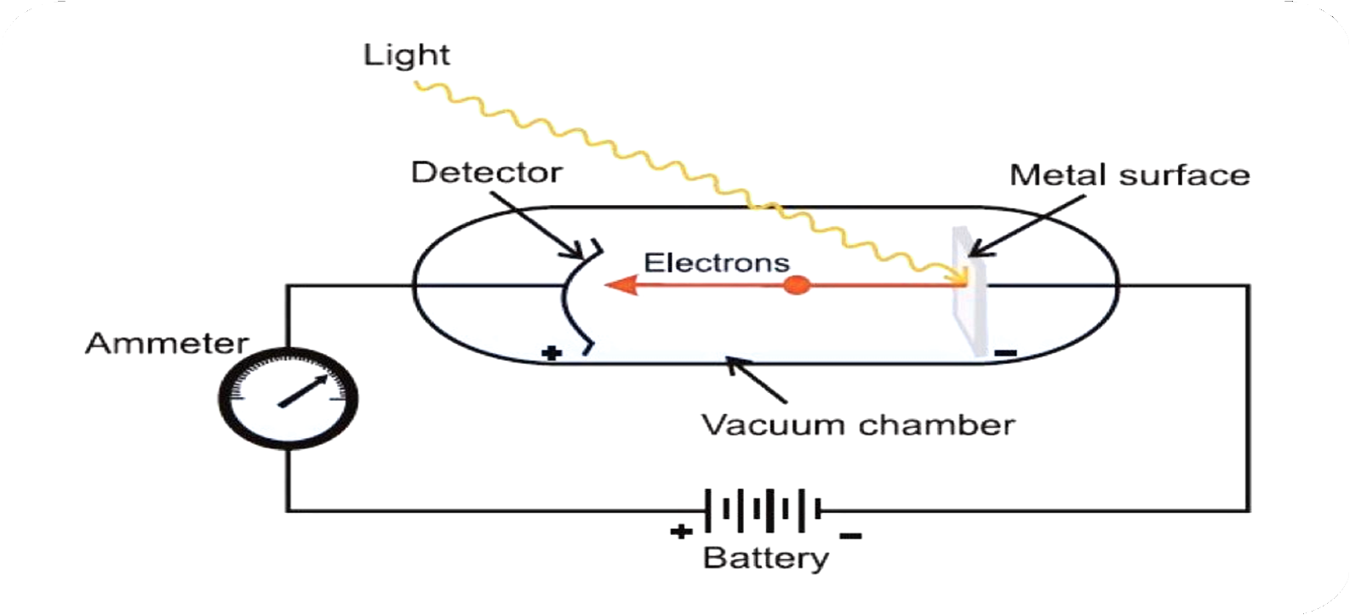
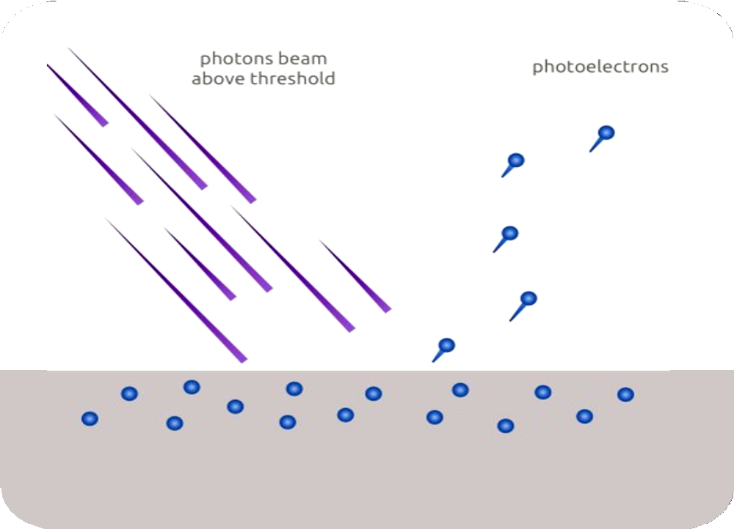
Photoelectric effect ( 1887)-H. Hertz
When certain metals such as K, Rb, Cs etc., were exposed to a beam of light, electrons were ejected. This phenomenon is called Photoelectric effect and the ejected electrons are called Photoelectrons.

Slide 40
Experimental observation:
Ejection of electron is instantaneous.
The number of photoelectron is proportional to intensity or brightness of light.
For each metal there is a characteristic minimum frequency v₀, below which photoelectric effect is not observed.
K.E frequency of light.( if v >v₀)

Slide 41


Slide 42
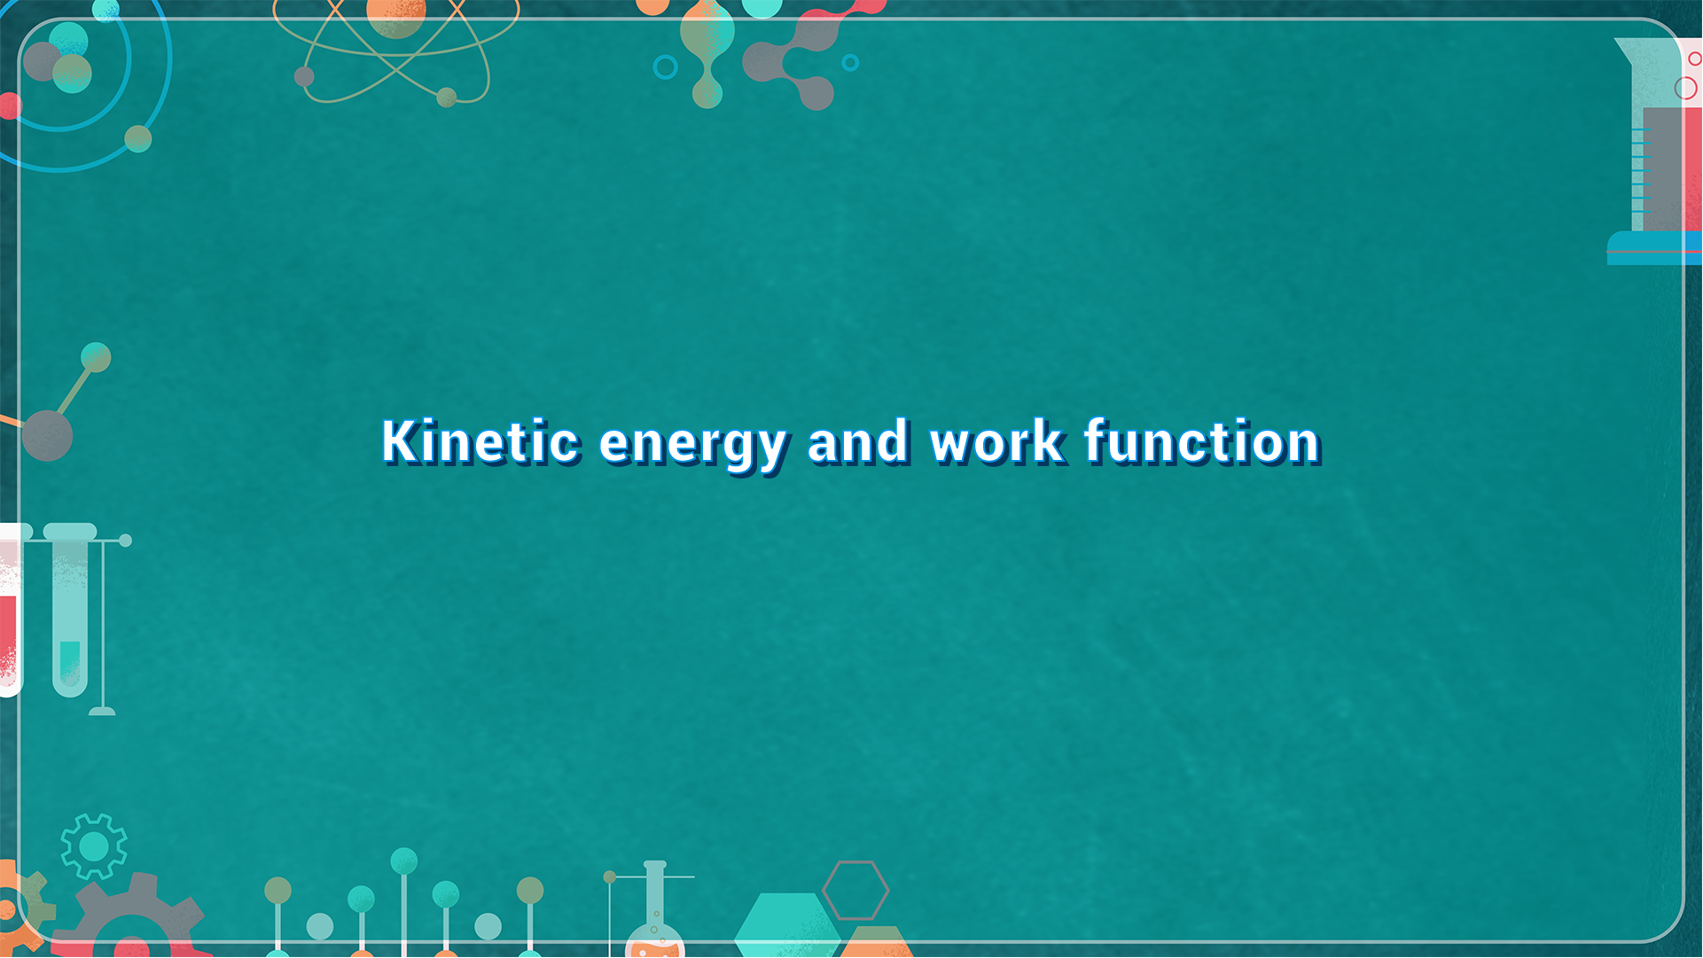
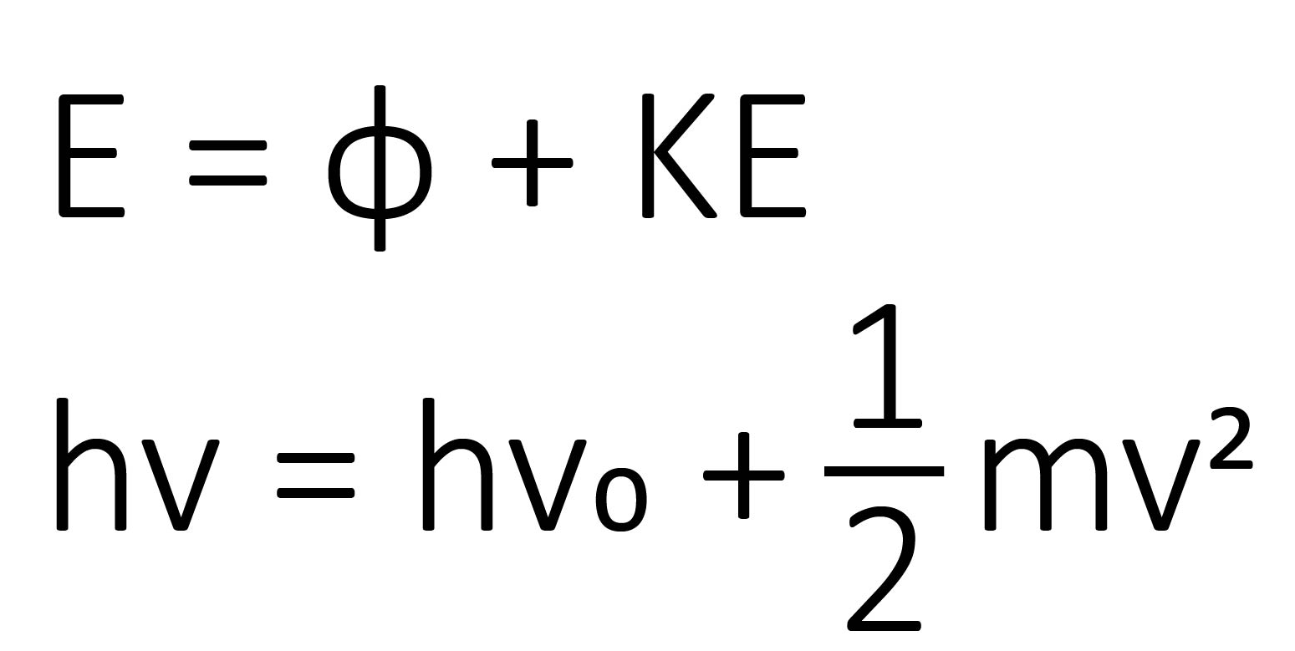
Kinetic Energy and Work Funciton

Slide 43
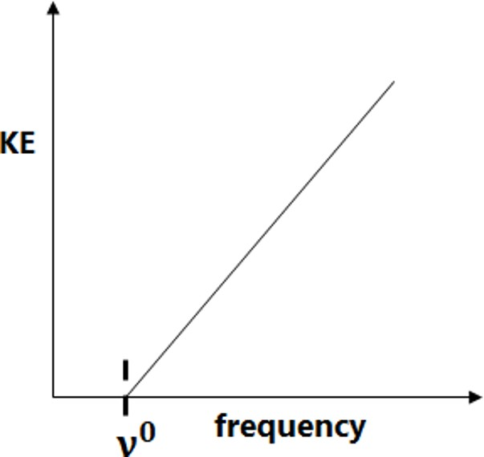
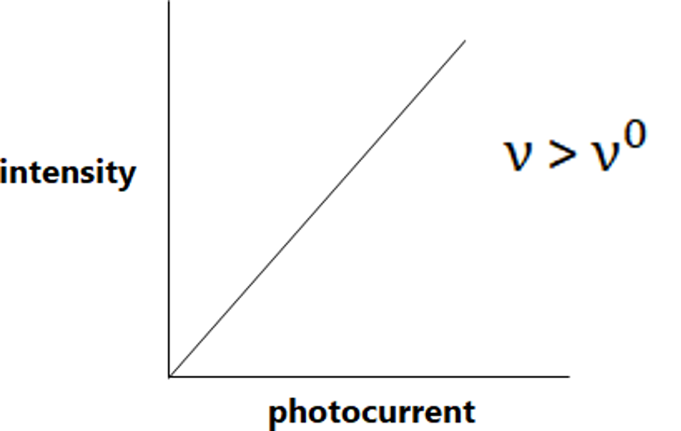
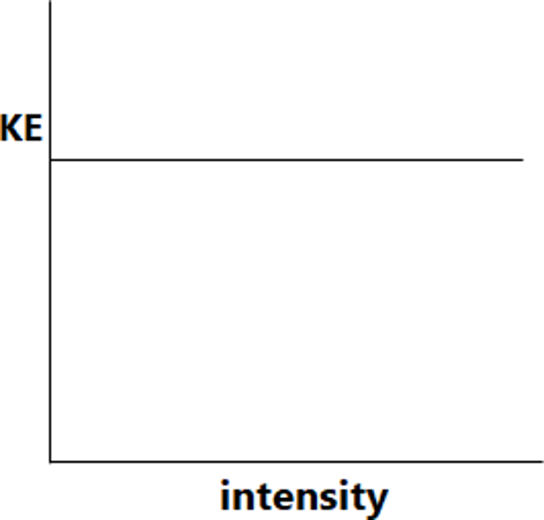
Einstein was able to explain photoelectric effect using Planck’s Quantum theory

Slide 47
Questions
The work function (w_{o}) whose threshold frequency (v_{o}) is 5.2 x 10¹⁴s⁻¹ ?
1. 3.44 x 10⁻¹⁹ J 2. 3.4 x 10⁻²³ J
3. 1.7 x 10⁻¹⁹ J 4. 17 x 10⁻²³ J

Slide 50
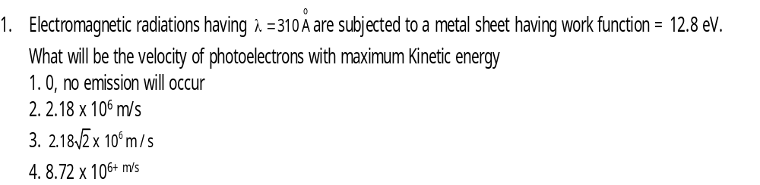
Questions

Slide 53
Evidence for the quantized electronic energy levels
The restriction of any property to discrete values is called quantization.
Spectrum
Based on nature
Based on origin
Continuous
Discrete
Emission
Absorption

Slide 54
Atomic Emission:
The light emitted by a sample of excited atoms of an element can be passed through a prism and separated into certain discrete wavelengths. Thus an emission spectrum, which is
a photographic recording of the separated wavelengths is called as line spectrum.
Atomic Absorption:
When white light is passed through un-excited atoms of an element and then through and a prism, the transmitted light is lacking in intensity at the same wavelengths a slit as are emitted in emission spectra. The recorded absorption spectrum is also a line spectrum and the photographic negative of the emission spectrum.

Slide 55
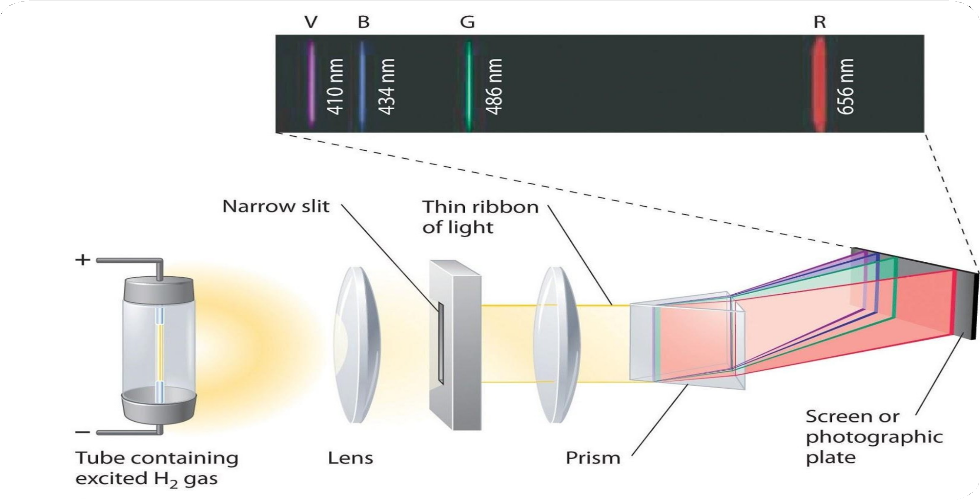
Line spectrum of Hydrogen

Slide 56
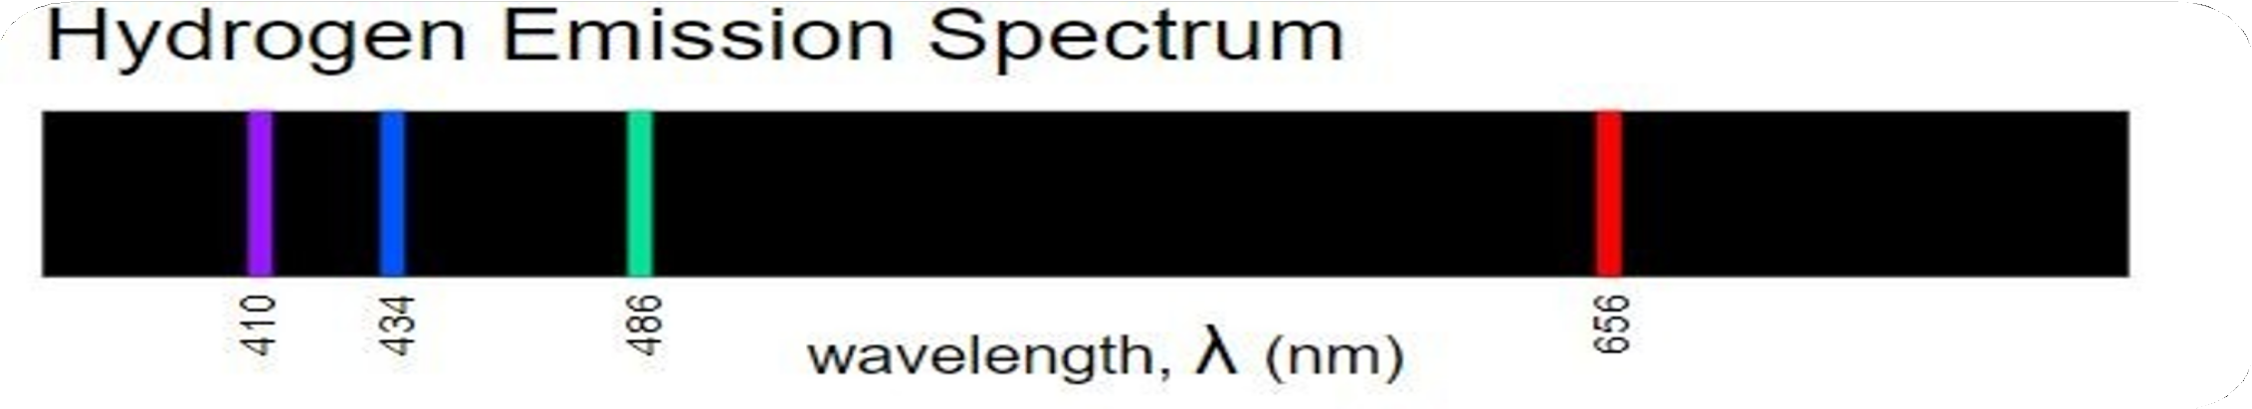
Since each frequency corresponds to a particular energy, the nature of this spectrum implies that the atom can only lose energy in certain ﬁxed amounts.
This leads to the conclusion that the electron in a H-atom can only exist at particular energy levels within the atom.
Energy is quantized.
The ﬁrst person to identify the pattern in the atomic spectrum of
H was the Swiss mathematician Johann Balmer.

Slide 57
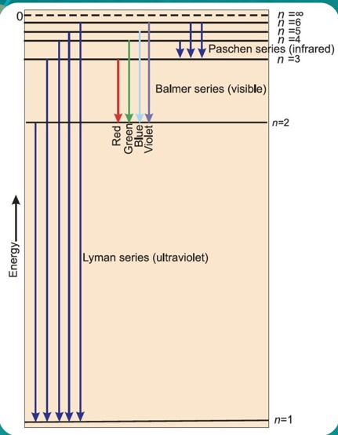
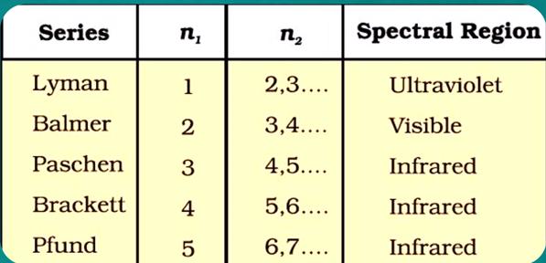

Slide 58
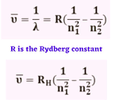

Slide 61
Questions
In H atom if e⁻ moves, from n^{th} orbit to 1st orbit by transition in multi steps, if there are total number of lines in spectrum are 10 then find out the value of n
1. 5 2. 10 3. 15 4. 20

Slide 63
Questions
No. of visible lines when an electron returns from 5th orbit to ground state in H spectrum :
1. 5 2. 4 3. 3 4. 10

Slide 65
Questions
Third line of Balmer series is produced by which transition in spectrum of H-atom
1. 5 to 2 2. 5 to 1 3. 4 to 2 4. 4 to 1

Slide 67
Questions

Slide 70
Questions

Slide 73
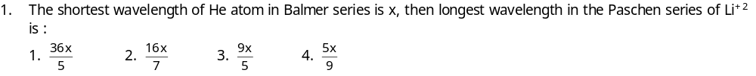
Questions

Slide 76
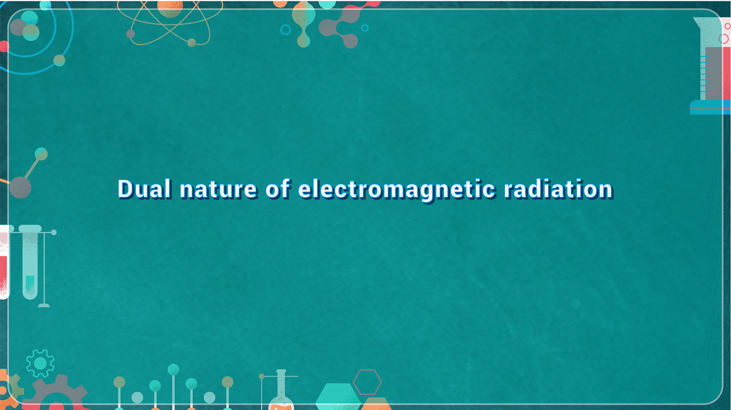
Dual Nature of Electromagnetic Radiation

Slide 78

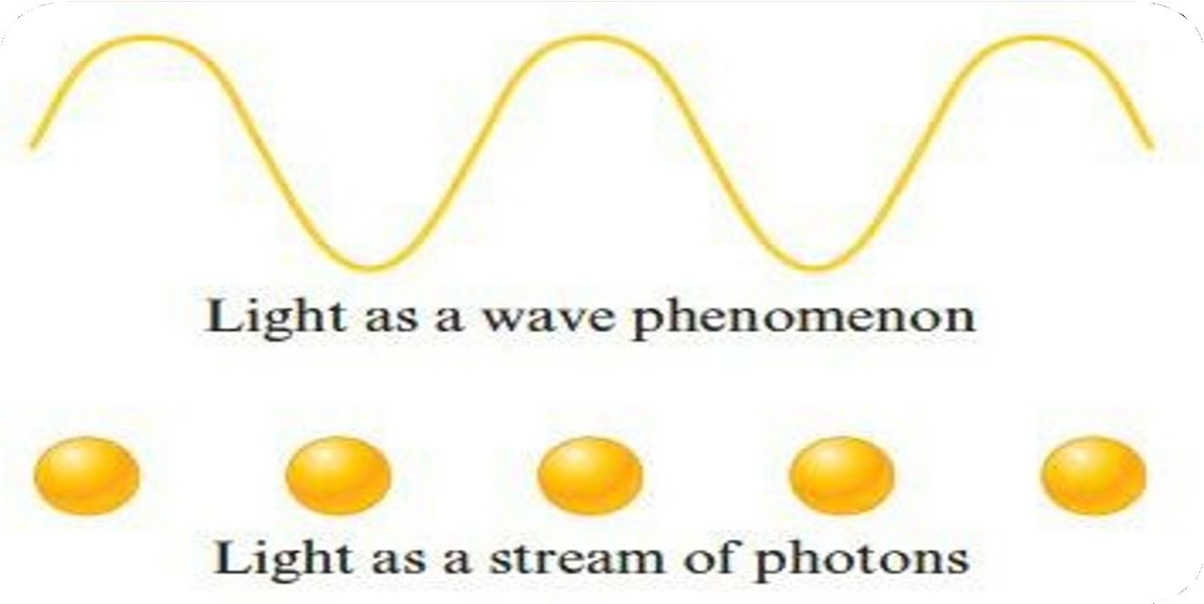
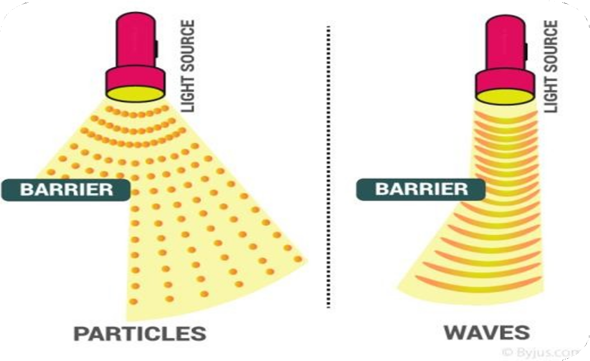
Dual nature of electromagnetic radiation
Light possess both particle and wave nature i.e., dual behaviour.
Particle nature is visible when radiation interacts with matter.
Wave nature is exhibited when it propagates.

Slide 79
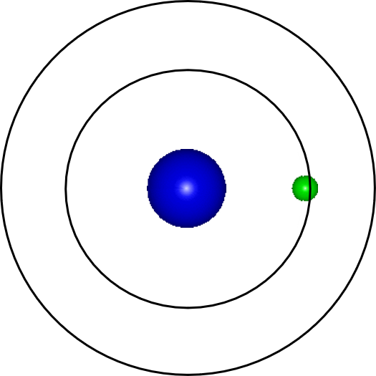
BOHR’s model for Hydrogen atom (Neils Bohr-1913)
Postulates of Bohr’s theory
Electrons revolve around the nucleus in specific permitted circular orbits and in no others.
While in these specific orbits, an electron does not radiate energy. These orbits are known as Stationary energy levels.

Slide 80
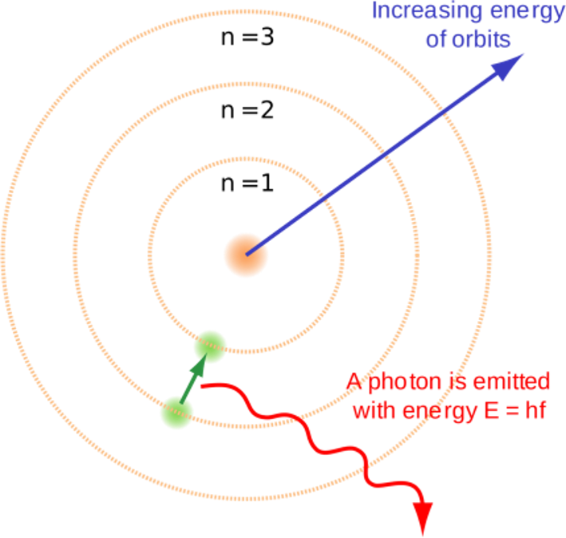
An electron can move from one energy level to another by absorbing/emitting required amount of energy.(Quantum theory)
The angular momentum of an orbit is always quantized and only those
orbits are possible whose angular momentum is integral multiple of h/2π
mvr= n. h
2π
Quantization of angular momentum

Slide 81
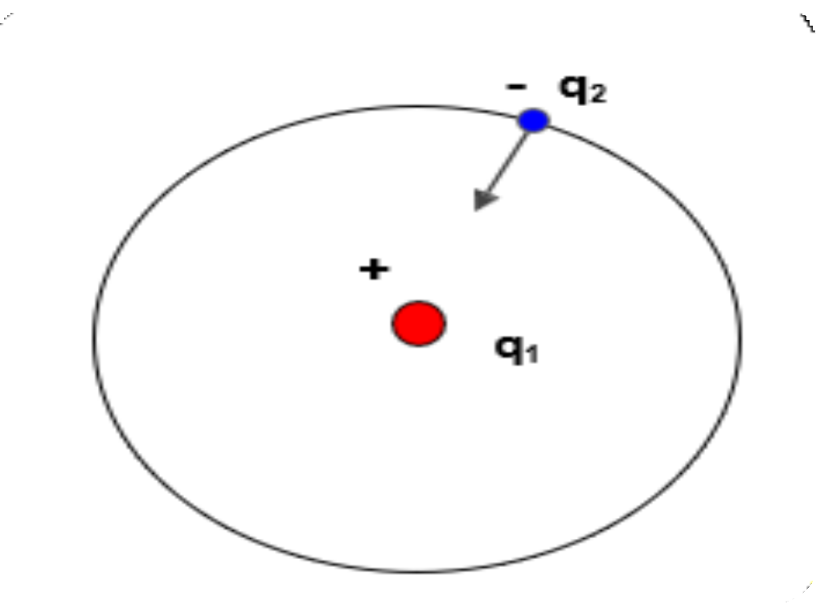
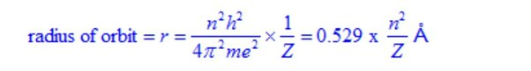
Calculation of the radius of the Bohr’s orbit

Slide 84
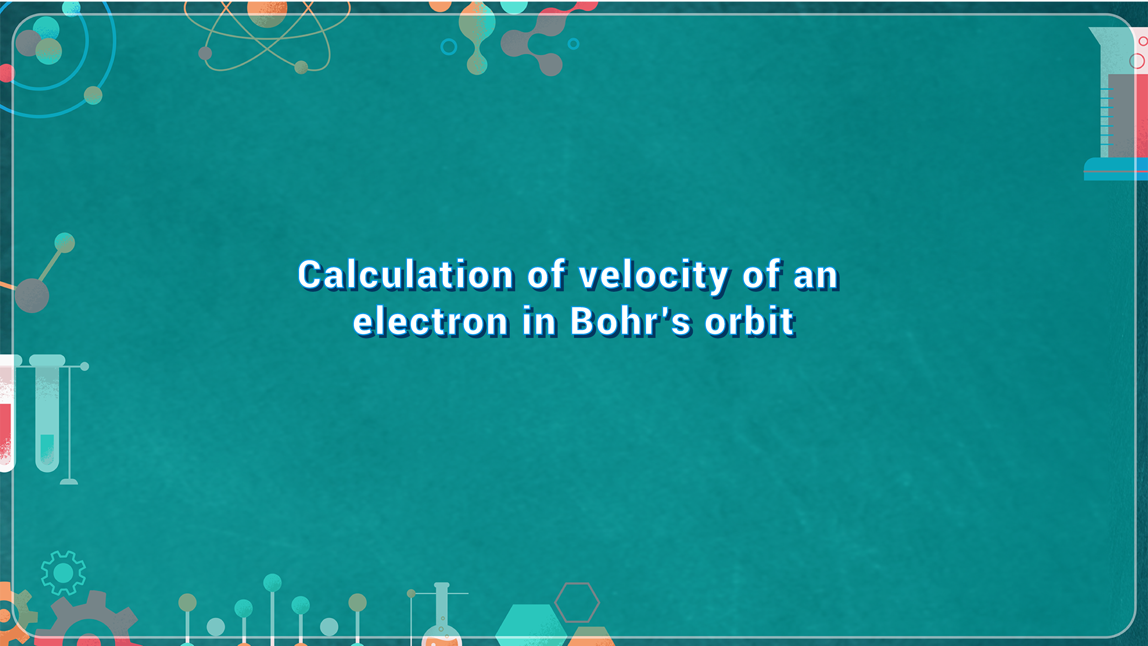
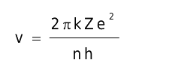
Calculation of Velocity of an
Electron in Bohr’s Orbit

Slide 87
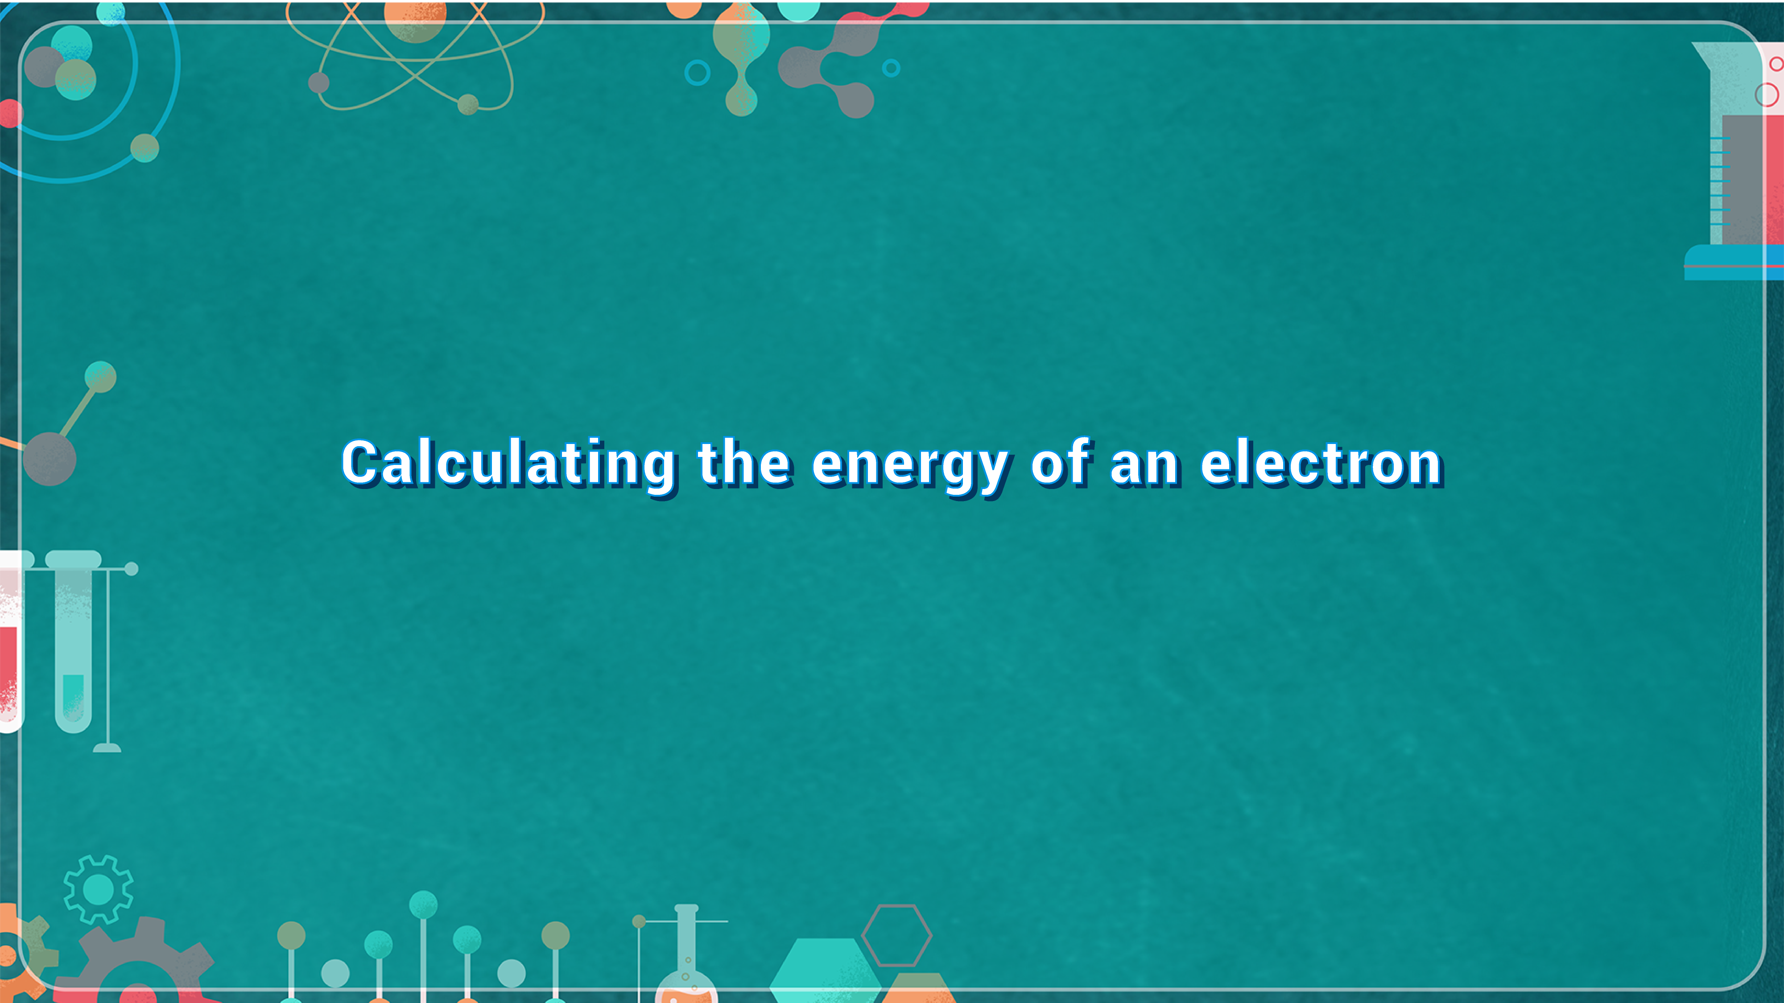
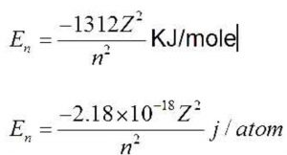
Calculating The Energy of An Electron

Slide 89
Why energy is –ve?
The energy of an electron at ∞ is arbitrarily assumed to be zero. This state is called Zero-energy state. When electron moves and comes under the influence of nucleus, it does some work and spends its energy in the process. Thus the energy of the electron decreases and becomes negative.
-ve sign also indicates that the electron is bound to the nucleus.

Slide 91
Failures of Bohr’s theory
He couldn’t explain the line spectra of multi-electron systems.
He couldn’t explain the distribution of electrons in the orbits.
He couldn’t provide mathematical support for the quantization of angular momentum.
He couldn’t explain splitting of spectral lines under inﬂuence of electric ﬁeld (Stark effect) and magnetic ﬁeld(Zeeman effect)
This is against de-Broglie and Heisenberg’s Uncertainty principle.

Slide 92
Questions
Bohr’s model can explain
1. The spectrum of hydrogen atom only
2. Spectrum of atom or ion containing one electron only
3. The spectrum of hydrogen molecule
4. The solar spectrum

Slide 93
Questions
When an electron jumps from L to K shell
1. Energy is absorbed
2. Energy is released
3. Energy is sometimes absorbed and sometimes released
4. Energy is neither absorbed nor released

Slide 94
Questions
Which of the following statements does not form part of Bohr’s model of the hydrogen atom
1. Energy of the electrons in the orbit is quantized
2. The electron in the orbit nearest the nucleus has the lowest energy
3. Electrons revolve in different orbits around the nucleus
4. The position and velocity of the electrons in the orbit cannot be determined simultaneously

Slide 95
Questions
If electron falls from n=3 to n=2, then emitted energy is
1. 10.2 eV 2. 12.09 eV 3. 1.9 eV 4. 0.65 eV

Slide 97
Questions
The angular momentum in second Bohr orbit of H-atom is x. Then find out angular momentum is 1st excited state of Li⁺² ion.
1. 3x 2. 9x 3. x/2 4. x

Slide 99
Questions
The value of first Bohr radius of hydrogen atom is
1. 0.529 x 10⁻⁷ cm 2. 0.529 x 10⁻⁸ cm
3. 0.529 x 10⁻⁹ cm 4. 0.529 x 10⁻¹⁰ cm

Slide 101
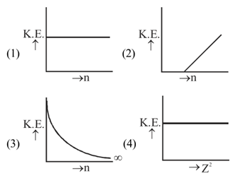
Questions
Which of the following is a correct graph

Slide 102
Questions
On the basis of Bohr’s model, the radius of the 3rd rbit is
1. Equal to the radius of first orbit
2. Three times the radius of first orbit
3. Five times the radius of the first orbit
4. Nine time the radius of first orbit

Slide 104
Questions
In a certain electronic transition in the hydrogen atoms from an initial state (1) to a final state (2) the difference in the orbital radius (r₁-r₂) is 24 times the first Bohr radius. Identify the transition.
1. 5→1 2. 25→1 3. 8→3 4. 6→5

Slide 107
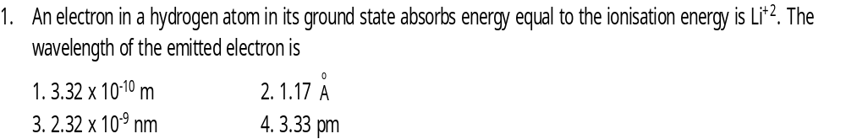
Questions

Slide 110
Questions
The spectrum of He⁺ is expected to be similar to that of :
1. Li²⁺ 2. He 3. Be 4. Na

Slide 111
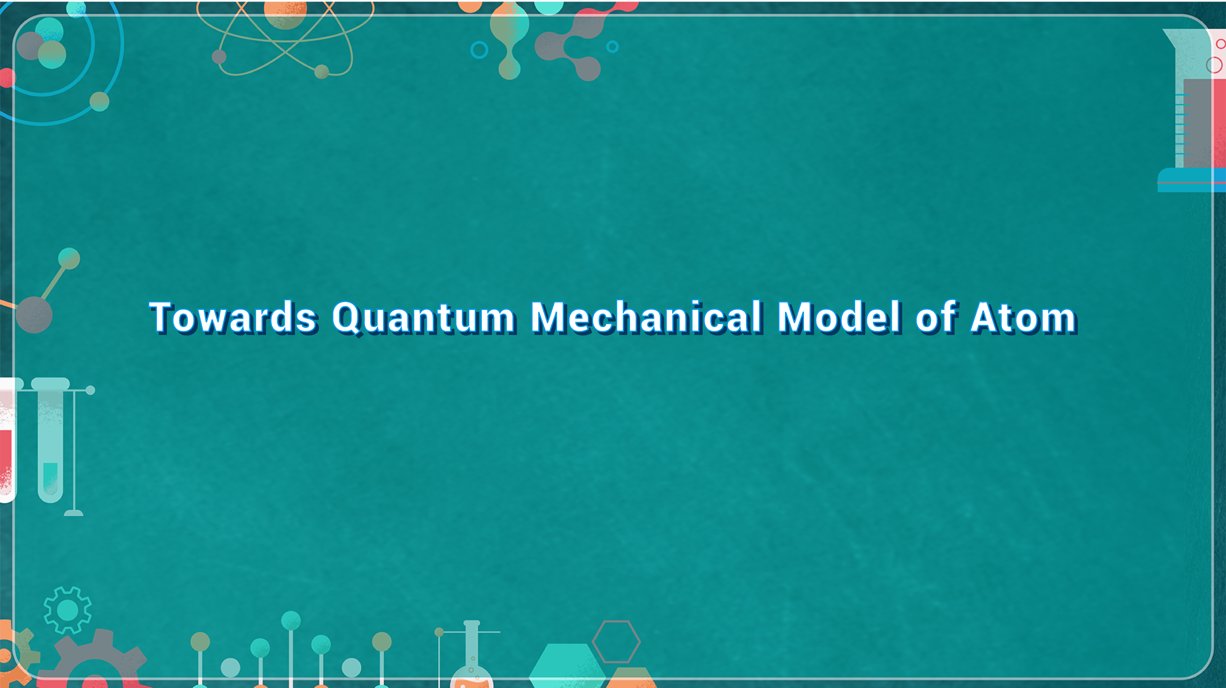
Towards Quantum Mechanical Model Of Atom

Slide 112
Towards Quantum Mechanical Model of Atom
Dual behavior of matter
Heisenber’s Uncertainty principle

Slide 113
Dual Nature of Matter De-Broglie (1924)

Slide 115
Questions
The de-Broglie wavelength of a particle with mass 1 gm and velocity 100m/sec is
1. 6.63 x 10⁻³³m 2. 6.63 x 10⁻³⁴m
3. 6.63 x 10⁻³⁵m 4. 6.65 x 10⁻³⁵m

Slide 117
Questions
The approximate wavelength associated with a golf ball weighing 200 g and moving at a speed of 5 m/h is of the order of
1. 10⁻¹ m 2. 10⁻²⁰ m 3. 10⁻³⁰ m 4. 10⁻⁴⁰ m

Slide 119
Questions
An electron, a proton and an alpha particle have kinetic energies of 16E, 4E and E respectively. What is the qualitative order of their de-Broglie wavelengths?

Slide 124
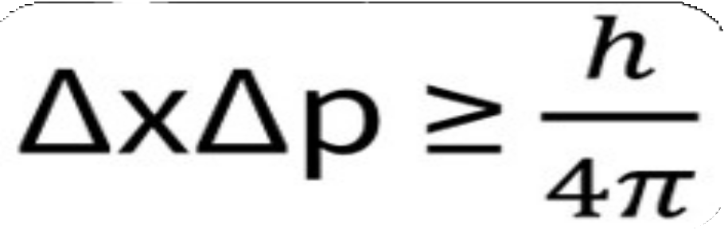
Heisenberg’s Uncertainty Principle
" It’s possible to determine simultaneousl, the exact position & exact momentum of an e⁻ ”.

Slide 126
It rules out the existence of definite paths or trajectories of e⁻ and other similar particles.
The effect of Uncertainty principle is significant only for the motion of microscopic particles and is negligible for macroscopic particles.
Q: why e⁻ doesn't exist in nucleus ?

Slide 127
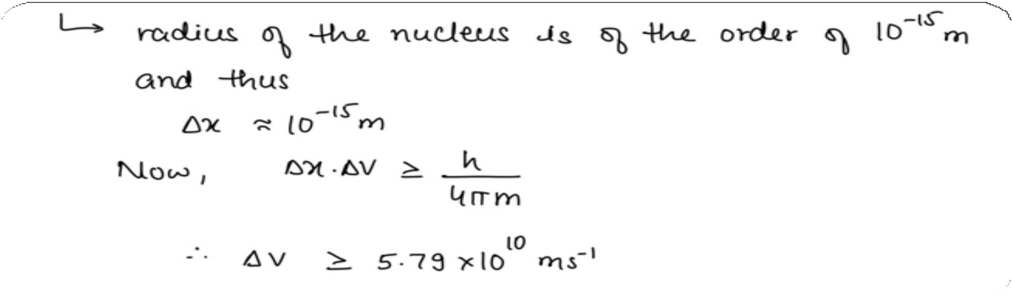
Q: Why e⁻ doesn't exist in nucleus ?

Slide 129
Questions

Slide 130
Questions
The uncertainty in the momentum of an electron is 1.0 x 10⁻⁵ kg ms⁻¹ . The uncertainty in its position will be : (h=6.626 x 10⁻³⁴ Js)
1. 1.05 x 10⁻²⁸ m 2. 1.05 x 10⁻²⁶ m
3. 5.27 x 10⁻³⁰ m 4. 5.25 x 10⁻²⁸ m

Slide 132
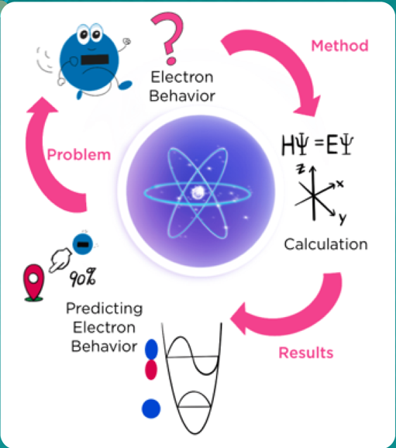

QUANTUM MECHANICAL
MODEL OF ATOM

Slide 133
QUANTUM MECHANICAL MODEL OF ATOM
The branch of science that takes into account this dual behaviour of matter is called quantum mechanics.
When quantum mechanics is applied to macroscopic objects (for which wave like properties are insignificant) the results are the same as those from the classical mechanics.

Slide 134

Schrödinger Equation

Slide 135



Slide 136

When Schrödinger equation is solved for hydrogen atom, the solution gives the possible energy levels the electron can occu py and the corresponding electron associated with each energy level.
When an electron is in any energy state, the wave function corresponding to that energy state contains all information about the electron. The wave function is a mathematical function whose value depends upon the coordinates of the electron in the atom and does not carry any physical meaning.
Such wave functions of hydrogen or hydrogen like species with one electron are called atomic orbitals.

Slide 137
Important Features of the Quantum Mechanical Model of Atom
The energy of electrons in atoms is quantized (i.e., can only have certain specific values), for example when electrons are bound to the nucleus in atoms.
The existence of quantized electronic energy levels is a direct result of the wave like proper- ties of electrons and are allowed solutions of Schrödinger wave equation.
Both the exact position and exact velocity of an electron in an atom cannot be determined simultaneously (Heisenberg uncertainty principle). The path of an electron in an atom there- fore, can never be determined or known accurately.
An atomic orbital is the wave function ψ for an electron in an atom.
Whenever an electron is described by a wave function, we say that the electron occupies that orbital.

Slide 138
The probability of finding an electron at a point within an atom is proportional to the square of the orbital wave function i.e., |ψ|² at that point. |ψ|² is known as probability density and is always positive.

Slide 139
Orbit
Orbitals
It is well defined circular path followed by revolving electrons around the nucleus
It represents planar motion of electron
The maximum no. of electron in an orbits is 2n² where n stands for no. of orbit.
Orbits are circular in shape. 5.Orbit are non directional in
character. Hence, they cannot
explain shape of molecules
6. Concept of well defined orbit is against Heisenberg's uncentainty principle.
It is the region of space around the nucleus where electron is most likely to be found
It represents 3 dimensional motion of an electron around the nucleus.
Orbitals can not accomodate more than 2 electrons.
Orbitals have different shape e.g. s-orbital is spherical, p orbital is dumb- bell shaped.
Orbitals (except s-orbital) have directional character. Hence, they can account for the shape of molecules.
Concept of orbitals is in accordance with Heisenberg's principle

Slide 140


Slide 141

Quantum Numbers

Slide 142

Quantum Numbers
The Bohr model was a one-dimensional model that used one quantum number to describe the distribution of electrons in the atom. The only information that was important was the size of the orbit, which was described by the n quantum number. Schrodinger's model allowed the electron to occupy three-dimensional space. It therefore required three coordinates, or three quantum numbers, to describe the orbitals in which electrons can be found.

Slide 143
Defines size and total energy of e⁻
Has integral values ie. 1,2, 3,4 or K, L, M, N etc.
No. of orbitals in nth orbit = N²
Max. no. of e⁻ in nth shell = 2N²
Principal (n)

Slide 145
Defines the shape of e- cloud or orbital and no. of subshells in a shell (orbit)
Can have values from 0 to n - 1
No. of orbitals in a subshell = 2ℓ+1
Azimuthal (ℓ)

Slide 147
Magnetic (m)
Defines the orientation of the sub shells
Can have values from -ℓ to +ℓ

Slide 149
Describes the spin angular momentum of an electron. It describes the quantum
state of an electron, including its energy, orbital shape, and orbital orientation.
Spin (s)

Slide 151
The only possible values of a spin quantum number are +½ or -½ (sometimes referred to as 'spin up' and 'spin down'). The value of spin is a quantum state, not something so easily understood as the direction in which an electron spins!

Slide 153
Questions

Slide 154
Questions
If n=3, then value of ‘l’ which is incorrect
1. 0 2. 1 3. 2 4. 3

Slide 155

Questions

Slide 156
Questions
The orbital angular momentum of an electron in 2s orbital is :

Slide 158

Questions

Slide 160
Questions

Slide 162

Questions

Slide 163
Questions
What are the values of the orbital angular momentum of an electron in the orbitals 1s, 3s, 3d and 2p ?

Slide 166

Shapes Of Orbital

Slide 167

Orbital s

Slide 168


Orbitals

Slide 169



Orbitals

Slide 170
Nodes
The region of zero probability density (excluding nucleus and infinity)
Total number of radial nodes = n − l − 1
Total number of angular nodes = l
Therefore,
total number of nodes = n − 1

Slide 171


Slide 172


Slide 176
Questions
Angular and sphereicla nodes in 3s –
1. 1,1 2. 1,0 3. 2,0 4,0,2

Slide 178
Questions
In which of the following pairs is the probability of finding the electron in xy-plane zero for both orbitals ?

Slide 180



Slide 183

Rules for ﬁlling of orbitals in atom

Slide 184

Energies of orbitals
For single-electron systems
For multi-electron systems

Slide 185

Rules for ﬁlling of orbitals in atom
Aufbau principle In the ground state of the atoms, orbitals are filled in order of their increasing energies.

Slide 186

Writing electronic conﬁguration of atoms

Slide 187


Slide 188


Slide 189
Pauli’s Exclusion principle
No two electrons in the same atom can have the same four quantum numbers.

Slide 190
Hund’s rule of maximum multiplicity
Pairing of e- in the orbitals belonging to the same subs hell doesn't take place until each orbital of that subshell has got one e- each with parallel spin.

Slide 192
Stability of Completely Filled
And Half-Filled Subshells

Slide 193



Stability of completely ﬁlled and half-ﬁlled subshells
Half-filled and completely filled subshells (particularly the latter) have some special stability. The stability of half-lled and completely filled subshells can be attributed to the following:
symmetrical distribution of electrons
exchange energy

Slide 195
Questions
Electron occupies the available orbital singly before pairing in any one orbital occurs, it is
1. Pauli’s exclusion principle
2. Hund’s Rule
3. Heisenberg’s principle
4. Prout’s hypothesis

Slide 196
Questions
When 4d subshell is complete, the newly entering electrons goes into
1. 5f 2. 5s 3. 5p 4. 6d Orbital

Slide 197
Questions
In a given atom no two electrons can have the same values for all the four quantum numbers. This is called
1. Hund’s rule
2. Aufbau’s principle
3. Uncertainty principle
4. Pauli’s exclusion principle

Slide 198
Questions
Electron occupies the available orbital singly before pairing in any one orbital occurs, it is
1. Pauli’s exclusion principle
2. Hund’s Rule
3. Heisenberg’s principle
4. Prout’s hypothesis

Slide 199
Questions
Read the Statement-I and Statement-II carefully to mark the correct option out of the options given below :
1. Both the statement are correct
2. Both the statement are incorrect
3. Statement-I is correct but Statement-II is incorrect
4. Statement-I are incorrect but statement II is correct

Slide 200
Questions
Statement-I: The 19th electron in potassium atom enters into 4s-orbital and not the 3d-orbital
Statement-II: (n+1) rule is followed for determining the orbital of the lowest energy state
Statement-I : Bohr model fails in case of multielectron species
Statement-II: It does not mention electron-electron interaction

Slide 201
Statement-I: 2p orbitals do not have spherical nodes.
Statement-II: The number of spherical nodes in p-orbitals is given by (n-2)

Slide 202
Questions
Assertion and Reason
Read the assertion and reason carefully to mark the correct option out of the options given below
If both Assertion and Reason are correct, and Reason is the correct explanation of Assertion
(2) If both Assertion and Reason are correct, and Reason is not the correct explanation of Assertion
3. If assertion is correct and Reason is incorrect
4. If Assertion is incorrect but Reason is correct

Slide 203
Questions
Assertion :- The ground state configuration of Cr is 3d⁵,4a¹
Reason : - A set of exactly half filled orbitals containing parallel spin arrangement provide extra stability

Slide 204
Questions
Assertion : - In an atom, the velocity of electron in the higher orbits keeps on decreasing
Reason : Velocity of electron is inversely proportional to radius of the orbit

Slide 205

Match the Column
Match the items in Column-I with those in Column-II

Slide 206

THANK YOU

